Slide 1
Links
Anchor Element | Absolute & Relative URLs | Section Links | Image Links & Targets
Notes:
Welcome to our lecture on Links. In this lecture we will go through thelinks,absolute and relative urls, section links, and image links and targets. Let’s start the lecture.

Slide 2

Introduction to Links
The <a> element defines a hyperlink that can navigate to another webpage, a location on the same page, download a file, or send an email.
The href attribute specifies the hyperlink's URL. For example, <a href="https://wikipedia.org/">Wikipedia</a> links to https://wikipedia.org/.
Special schemes like mailto start actions, such as launching an email program.
Notes:
The anchor element creates hyperlinks for navigation, downloads, or sending emails. It uses the href attribute to specify the hyperlink URL. For example, an anchor tag linking to Wikipedia redirects the browser to the website when clicked. Special schemes like mailto in the href attribute can trigger specific actions, such as opening an email program to compose a message.

Slide 3
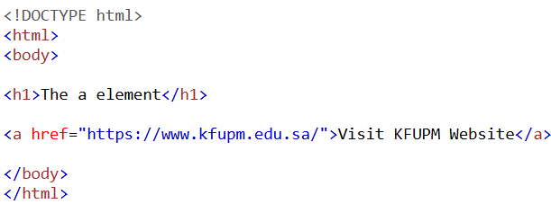
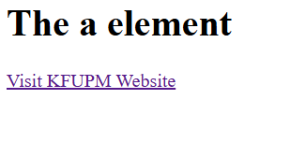
Example
Output
Notes:
This example demonstrates the use of an anchor element to create a hyperlink. The HTML code includes an anchor tag with the href attribute set to https www dot kfupm dot edu dot sa. The displayed text is Visit KFUPM Website, and clicking the link redirects the user to the specified URL. This is a simple way to create clickable links in a webpage.

Slide 4
Absolute and relative URLs
Absolute URL: A complete URL, e.g., <a href="http://example.com/test.html">test</a>.
Relative URL: A path relative to the current document, e.g., <a href="test.html">test</a>.
Notes:
This slide explains two types of URLs. An absolute URL is a complete web address, such as an anchor tag linking to http example dot com slash test dot html. A relative URL specifies a path relative to the current document, such as an anchor tag linking to test dot html. Absolute URLs are used for external links, while relative URLs are typically used for links within the same website.

Slide 5
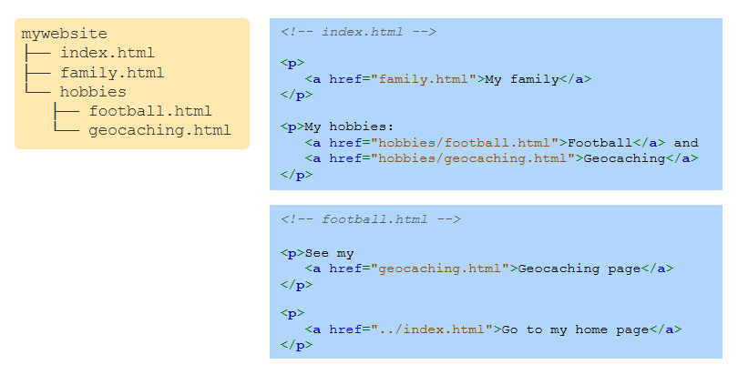
Example of URLs
Notes:
This example illustrates the use of relative URLs within a website structure. From index.html, links point to family.html, hobbies/football.html, and hobbies/geocaching.html. In football.html, a link to geocaching.html uses a relative path, and a link to the homepage index.html uses ../ to move up one directory level. Relative URLs help navigate within the website efficiently.

Slide 6
Section links
A URL can link to a specific section of a document using a hash (#) and fragment identifier.
Example: https://en.wikipedia.org/wiki/Computer_science#History links to the "History" section of the "Computer_science" page on Wikipedia.
Notes:
This slide explains section links in a URL. A URL can direct to a specific section of a document by using a hash symbol followed by a fragment identifier. For example, the Wikipedia URL links directly to the History section of the Computer science page on Wikipedia. This method is useful for navigating large documents.

Slide 7
Rules for ID Attribute
Adding an id attribute creates a fragment identifier for linking to specific locations in a document.
Rules for id values:
No whitespace allowed (e.g., "history 123" is invalid).
Cannot start with a number (e.g., "3section" is invalid).
Case sensitive (e.g., "History" and "history" are different).
Must be unique within the document.
Notes:
The id attribute creates a fragment identifier for linking to specific sections of a document. Certain rules apply to id values. They cannot contain spaces, so history space 123 is invalid. They cannot begin with a number, so 3section is also invalid. Id values are case sensitive, meaning History and history are different. Finally, each id must be unique within the document to prevent conflicts.

Slide 8
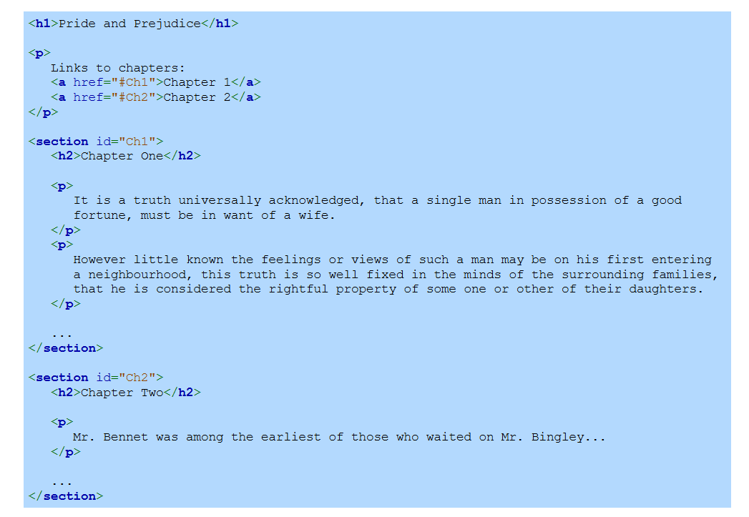
Example
Notes:
This example demonstrates how the id attribute is used to create section links within a webpage. The document begins with a heading and links to two chapters using anchor elements with href attributes pointing to the id values ch1 and ch2. Each chapter is enclosed in a section tag with a matching id. Clicking the links navigates directly to the respective chapters, showcasing in-page navigation.

Slide 9
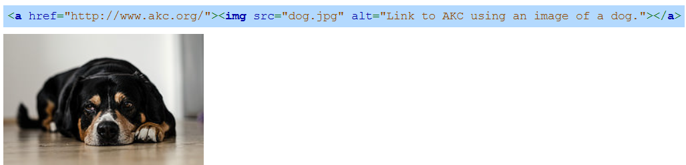
Image links
Hyperlink content can include text or any valid HTML, such as images.
An image inside a hyperlink creates a graphical link, e.g., an image of a dog linking to the American Kennel Club.
Notes:
Hyperlinks can include text or any valid HTML, such as images, for their content. Using an image inside a hyperlink creates a graphical link. For example, an image of a dog within an anchor element links to the American Kennel Club website. This allows visual elements like images to serve as clickable links, enhancing the user experience and webpage design.

Slide 10
Image targets attribute
The target attribute in an anchor element specifies how the link opens.
_self opens the link in the same tab (default), while _blank opens it in a new tab or window.
Notes:
The target attribute in an anchor element determines how the hyperlink opens. The default value, self, opens the link in the same tab or window. Using the target value blank opens the link in a new tab or window. For example, an anchor element linking to the Wikipedia main page with the target attribute set to blank will open the page in a separate tab, enhancing user navigation options. Thanks for watching the lecture.

